Slide 1
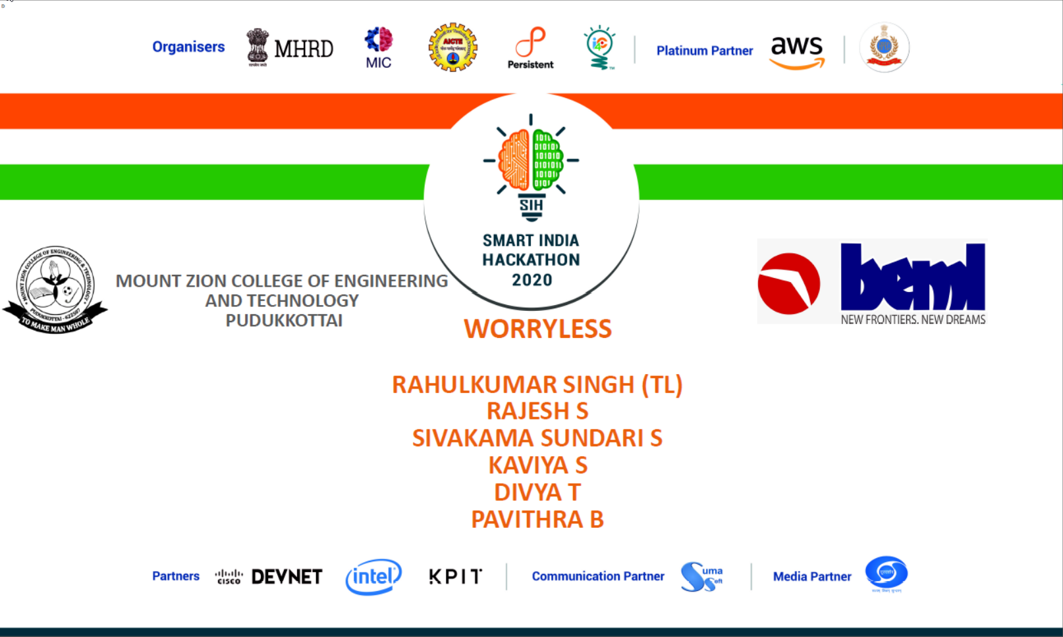

Slide 2
BH60M & BH100 with Electronic Transmission
Securing the CAN J1939 2.0B Communication Protocol, to make RIDES SAFER!

Slide 3

Hacking http://rnddev.azurewebsites.net/
Stages of Hacking:
The stages depicted below in the image will be the stages taken by us as a hacker to exploit http://rnddev.azurewebsites.net/
Enumeration

Slide 4
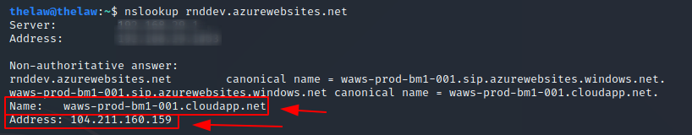
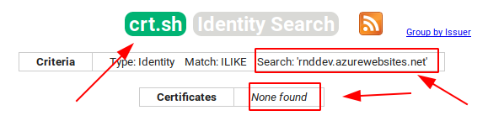
Hacking http://rnddev.azurewebsites.net/
Reconnaissance: Passive Recon & Active Recon
IPv4 identification using nslookup:
Identifying other domain linked to rnddev.azurewebsites.net using crt.sh tool: (Didn’t find any)

Slide 5
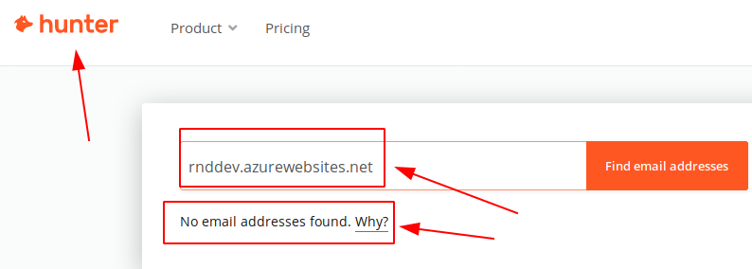
Hacking http://rnddev.azurewebsites.net/
Reconnaissance: Passive Recon & Active Recon
Identifying any email address with the above domain using hunter.io tool: (Didn’t find any)

Slide 6
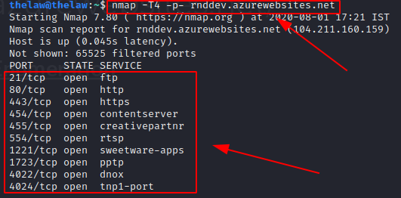
Hacking http://rnddev.azurewebsites.net/
Scanning and Enumeration
Scan which ports are empty using nmap tool:
From hacker point of view, the above findings will be very crucial during exploitation process. Open ports are like gems for hackers if they are not patched.

Slide 7
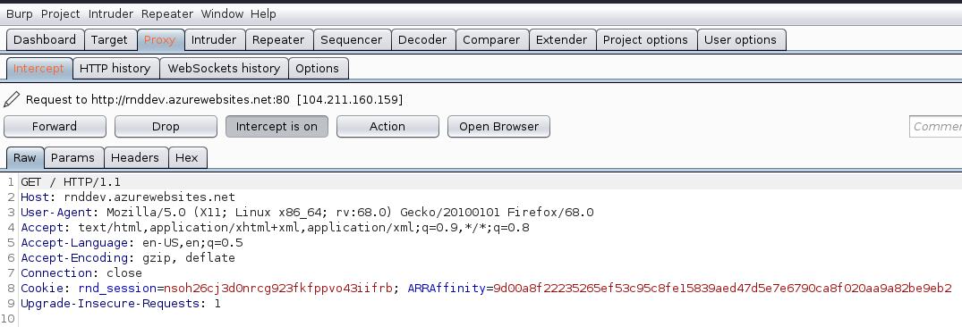
Hacking http://rnddev.azurewebsites.net/
Scanning and Enumeration
Intercepting request using BurpSuite tool:

Slide 8
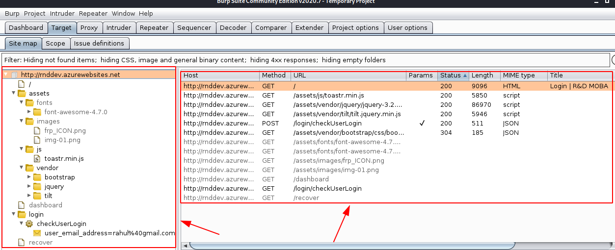
Hacking http://rnddev.azurewebsites.net/
Scanning and Enumeration
Finding directories using BurpSuite tool:

Slide 9
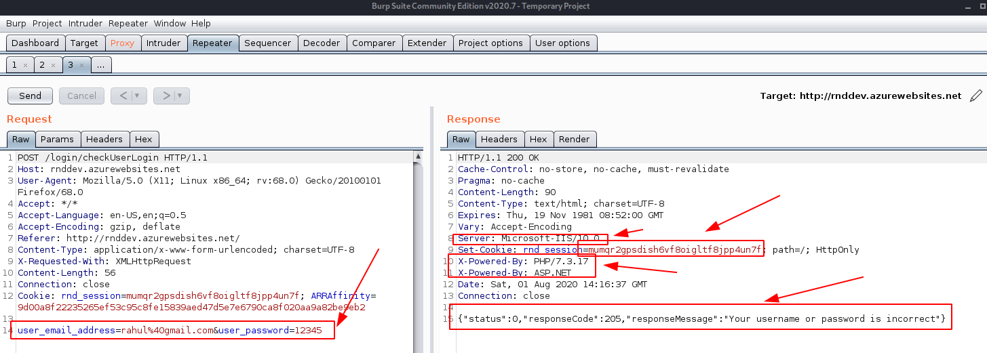
Hacking http://rnddev.azurewebsites.net/
Scanning and Enumeration
Checking for information disclosure using BurpSuite tool:
Information about server and the website is disclosed. Error messages might disclose if SQL Injection is possible.

Slide 10
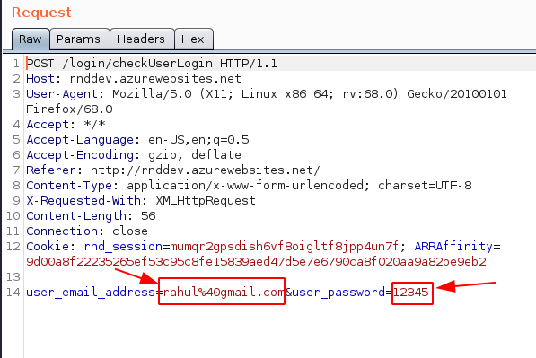
Hacking http://rnddev.azurewebsites.net/
Scanning and Enumeration
Understanding based on previous findings in BurpSuite tool:
Using Intruder option in BurpSuite, Sniper Attack can be performed in the input fields.

Slide 11
Hacking http://rnddev.azurewebsites.net/
Scanning and Enumeration
Understanding based on previous findings in BurpSuite tool:
Using Intruder option in BurpSuite, Sniper Attack can be performed in the input fields.

Slide 12
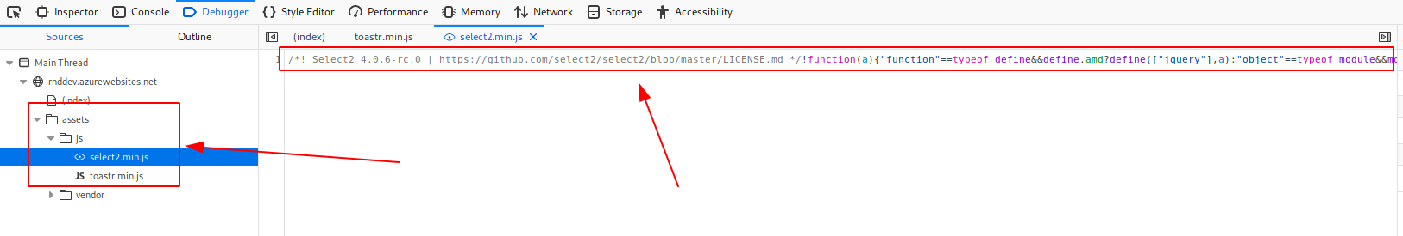
Hacking http://rnddev.azurewebsites.net/
Scanning and Enumeration
Using Inspect Element option in the browser:
The Javascript files might become handy, during exploitation stage.

